Slide 1
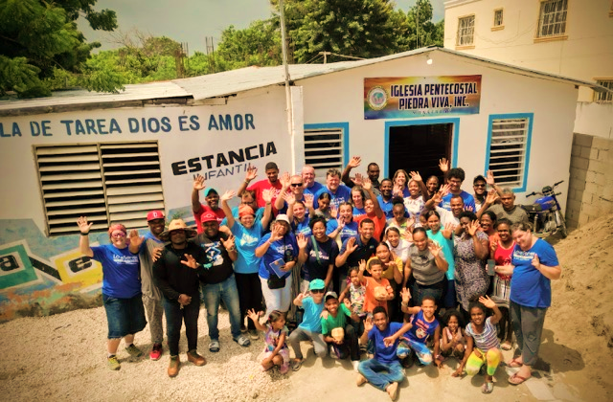
LoveServes International
Mission Trip Meeting
Team Meeting #3

Slide 2
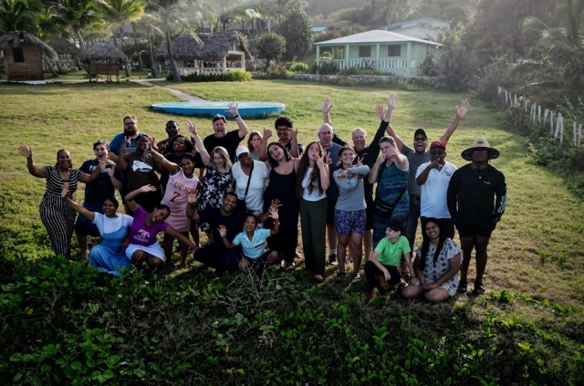
AGENDA
Prayer for our trip
Icebreaker
Discuss trip Logistics
Review Ministry schedule
Explore cultural impacts
Language barriers
Wrap up and head out!
Notes:
Snacks and beverages
Pens
Post it notes (6-8 per person)
Strips of yarn cut enough for each person (1 strip of yarn approx. 2 feet long
Laptop and charging cord and clicker
TV set up with AV connector
Determine meeting location and who will bring snacks and beverages.
Make sure you get confirmation from each team member to determine who is coming. (Meetings are mandatory)
Review notes including Learn-Servant-Storyteller, print out enough copies of Learner, Servant, Storyteller for each person.
Watch video to check sound and video functions ahead of the meeting

Slide 3

Prayer –
How can we pray for each other?
Notes:
5-10 minutes

Slide 4
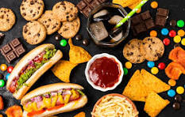
ICEBREAKER!
What’s one food you wish you could bring on the trip but can’t?
Notes:
Facilitator note:
Quickly go around the room and ask everyone the icebreaker question.
Facilitator make note of talents that could be useful on the trip!
Choose your own question if you would like!

Slide 5


TRIP LOGISTICS (TEAM LEADER)
Flight Schedules
Transportation to the airport
Review packing needs
Coordinate Ministry supplies packing
Mission Journals
Tee shirts
Day off activity on the trip preparation
What else is on your mind?
Notes:
Logistics/ Q & A (TEAM LEADER) Review flight schedule and finalize transportation to airport. Who is helping to pack ministry supplies in their suitcase? Be sure to pack your Missions Journal and Team Tshirt in your suitcase (do not wear the shirt on the plane; save it for the last day in-country for the celebration with the church community). Any final questions?

Slide 6

Review the Ministry and daily schedule
Other ministry Leader – _________________
Youth Ministry: Activity & topics – ______________________
Worship Leader – _____________________
Kids program (approx. _______Kids) – 3 parts: Bible Lesson/songs; Games; Kid Craft
    Leader roles:
    Bible Lessons - ___________________________
    Kid Craft _______________________
    Games - _______________________
Daily Team Devotions:
Sunday – _______________ Mon – _____________ Tues – __________Wed – ______________ Thurs – _________ Fri – ____________ Sat –_______________
Notes:
Go over “week at a glance”/weekly schedule. Discuss special events and day off as well. Review daily assignments (example below):

Slide 7
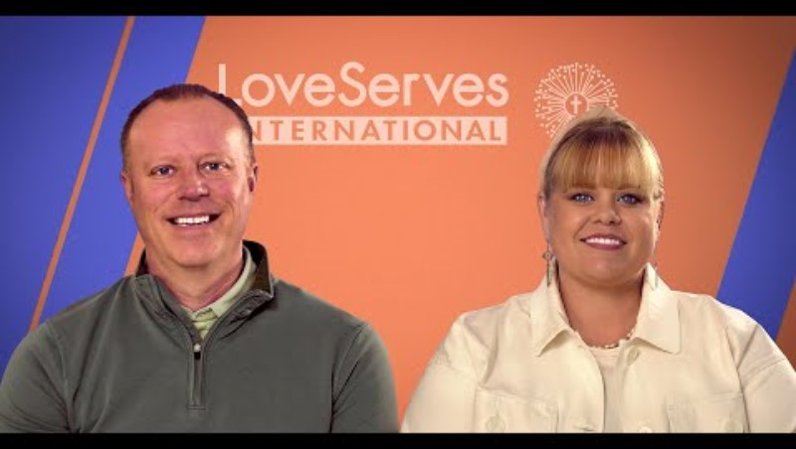

Slide 8


Slide 9
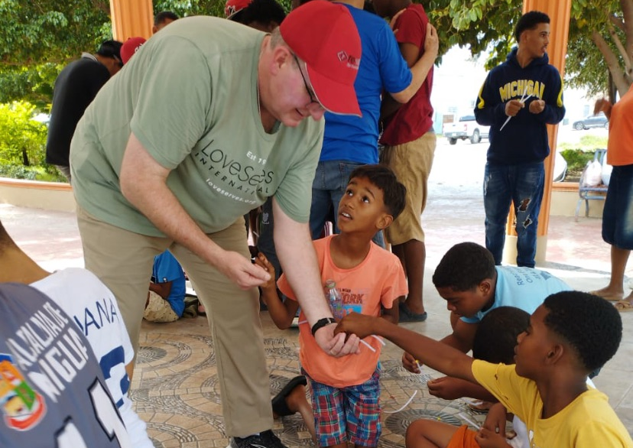
Culturally Sensitive Giving - Debrief
Our giving must be culturally sensitive. We must come to the needs of this culture as a learner asking some critical questions:
What have I come here to do?
How can it be harmful to give a gift to meet such an obvious need?
So … how should I give?

Slide 10
What have I come here to do?
You have come to meet very specific needs that are within your ability to meet. You will help build a church, school, home or clinic. You will leave behind a vital structure that will affect the lives of these people for years to come. You will share the love and message of Christ to children and their families and model for them the compassion of a servant of God. Through this you will make an impact … and YOU will be changed!
What you will not do is change the economic situation of the community or alter the reality of poverty for these people. You are helping in a significant way, but you cannot do it all. The message is … concentrate on what you CAN do, not what you cannot.
Notes:
What a great reminder about our tendency to focus on “stuff” – or lack of “stuff”. But as we talked about in our first meeting, the lack of “stuff” is not the true poverty. Our brokenness is the real poverty. And the lack of self-worth; not knowing that your are loved deeply by our creator and Lord, Jesus Christ. It begs the question, who are the poor?
You are surrounded by great need … what do you do? How do you respond? Anyone who has been on a short-term mission trip has struggled with these pressing questions. The tension is good. You are out in the field facing awesome need, but you also know this place is different. The rules you have been used to at home may not apply here. The awful truth is that giving some money today to the little child holding out his hand or to the pastor for his special project can do more harm than good.

Slide 11
How can it be harmful to give a gift to meet such an obvious need?
It may feel good to give your hat to a child you have come to know or some money to a parent, but that simple act of giving can lead to ill feelings between neighbors, an unnatural sense of dependency, or even a riot as the community comes out to receive their share of the gifts.
The next mission group that comes in next will face a community that expects to receive gifts, and grave complications can result.
A general rule is to not give gifts of money or things to individuals.
Realize the power of your gifts both positively and negatively. Many a pastor has been unnaturally tempted by the availability of money from well-meaning Christian visitors. We must resist our desire to meet an immediate need for one person to the detriment of meeting long-term needs for many.

Slide 12
So … how should I give?
It is always best to channel your giving of clothes, tools, money, etc. through an organization that knows the country, culture and local leadership. Instead of risking the problems that can come from giving to individuals, focus your giving on a specific project that will have broader effect.
Our ministry partner, ReVision, will collect all donation, including clothes you would like to leave behind, before you leave. Then ReVision gives the donations directly to the pastor who KNOWS the real needs of the families in the community and the CHURCH can minister to those families and individuals with your donations
If you have a desire to make a monetary donation towards the project you worked on, that can be made through LoveServes. LoveServes will work through the local coach working with that pastor to assess the progress of the project and make sure your gift is appropriately applied.
Notes:
Culturally sensitive giving can be a real challenge to your heart when you first encounter the local community where your team is serving. But remember that the genuine relationships you build, the hard work you put in alongside other brothers and sisters in Christ from the local church, and the encouragement you provide to the pastor and church leaders by doing ministry with them, are precious gifts that restore brokenness (spiritual and emotional) and can have an eternal ROI.
God has GREAT things plan for your team! Dios te bendiga!

Slide 13



Let’s hear from a veteran Mission tripper on how they share their story or journey with God.
Notes:
Optional if someone would like to share

Slide 14
Relationships through Languages

Slide 15
Verbal Communication:
Your group’s effort in language-learning communicates to another culture that you care about them. It is a bridge-builder.
In learning another language, the key word is ‘relax!’ The goal here is not to become an expert in the language, but to acquire enough of the language to allow you to build relationships.
In most cases, you will have a translator with you.
Keep in mind that the goal is not language learning, but rather getting to know, love, and serve people cross-culturally.”

Slide 16
Let’s Practice!
SPANISH | ENGLISH
Hola | Hello
Me llamo... | My name is...
Como se llama usted? | What is your name?
Estoy aprendiendo Español | I am learning Spanish.
Como se llama esto? | What is this called?
Gracias por su ayuda | Thank you for your help.
Adios. Hasta luego | Good-bye. See you later
Dios te bendiga! | God bless you!
Notes:
Get in pairs and practice a few basic sayings
NOTE: If you have Spanish speaking team members already, partner them up with someone that is having difficulty

Slide 17

Final Reminders:
Meeting up time and location on the day of departure
Be sure to pack your:
  Passport
  Immigration entry and departure forms (or save the QR codes on in your photos)
  LoveServes t-shirt
  Mission trip devotional
Wear your mission trip H.A.T.
Attitude of Humble – Adaptable – Teachable

Slide 18
Pray for:
What the team is about to experience together.
For safe travels.
For a great learning experience.
Notes:
5-10 minutes

