Slide 1
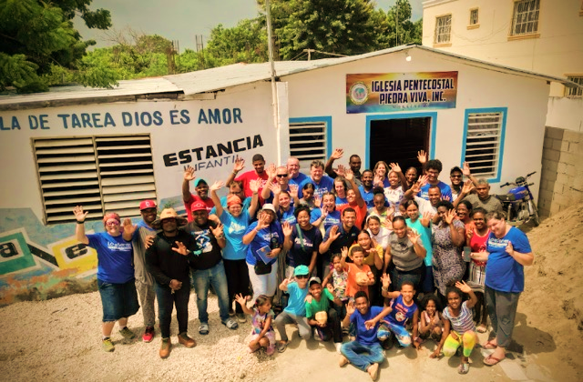
LoveServes International
Mission Trip Meeting
Team Meeting #2 –
Why Mission Trips?

Slide 2
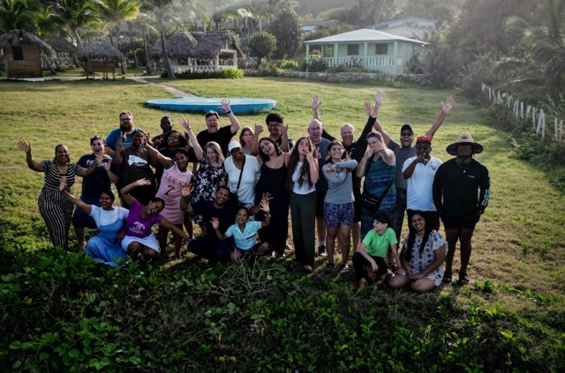
AGENDA
Icebreaker
Prayer for our trip
Discuss trip Logistics
Review day #1 videos
Continue to learn about your impact to the community
Identify roles on the trip
Share your story
Wrap up and next steps
Notes:
Snacks and beverages
Pens
Post it notes (6-8 per person)
Strips of yarn cut enough for each person (1 strip of yarn approx. 2 feet long
Laptop and charging cord and clicker
TV set up with AV connector
Determine meeting location and who will bring snacks and beverages.
Make sure you get confirmation from each team member to determine who is coming. (Meetings are mandatory)
Review notes including Learn-Servant-Storyteller, print out enough copies of Learner, Servant, Storyteller for each person.
Watch video to check sound and video functions ahead of the meeting

Slide 3

ICEBREAKER!
What is one word to describe your excitement about the trip and one word to describe any apprehension?
Notes:
Facilitator note:
Quickly go around the room and ask everyone the icebreaker question.
Choose your own question if you would like!

Slide 4
TRIP LOGISTICS (TEAM LEADER)
Next meeting: _________________
REMINDER: Balance is due _________ (60 days prior to departure date)
Project funding: $______________ needed
Day off activity on the trip: _____________________
  Did your team already decide from the options noted by ReVision?
  Is there an extra cost?
  What do we need to bring and wear on the free day?
Notes:
Facilitator notes:
Ministry:
Share the initial list of work
Start discussing what is needed
Ask for initial volunteers.
Remind everyone that they will not have to do anything alone! We will guide them!
Food abroad can be a source of anxiety for some people especially with allergies. Briefly describe with meals would look like and what snacks to bring
Packing list: have experienced traveler discuss what they do and some of the things they have learned over the years

Slide 5
TRIP LOGISTICS
Flights/Carpools:
Confirm that all team members have their flight purchased. Share flight details already booked
Example: Most of us are flying out of ___________ at ___________ and returning on the ____________ flight.).
ALL team members must arrive/depart from the same airport, on the same days and within a two-hour window of each other (if flying on different airlines)
Make sure they send a copy of the flight itinerary to Patricia@loveserves.org and copy Mission@loveserves.org
Luggage/packing list:
Check the luggage requirements (40 lbs on most airlines)
You can also bring a backpack (aka Personal Item) for free.
NOTE: Please see the packing list on Participant Guide page 17 and review on the next slides
Notes:
Facilitator notes:
Ministry:
Share the initial list of work
Start discussing what is needed
Ask for initial volunteers.
Remind everyone that they will not have to do anything alone! We will guide them!
Food abroad can be a source of anxiety for some people especially with allergies. Briefly describe with meals would look like and what snacks to bring
Packing list: have experienced traveler discuss what they do and some of the things they have learned over the years

Slide 6
Packing List - Clothing
4-5 sets of work clothes (long pants and t-shirts with sleeves are required on worksites; capri pants are acceptable for women)
3-4 sets of clothes to wear after work and on day-off
Fingertip length shorts are OK at camp/lodging and on day-off.
No tank tops or sleeveless shirts in the community where we will be working or ministering but are fine on our day off and around camp.
1-2 outfits for church service (bring extra pair of shoes so you aren’t wearing work shoes to services)
Men should wear long pants and collared shirt (lightweight polo shirts are good)
Women should wear skirts or dresses that reach the knees, no tank tops or sleeveless shirts
2 pair of work gloves
8 sets of underclothing
1 pair of sturdy work shoes, boots, or sturdy tennis shoes
5 pair of work socks
Lightweight pajamas, please be conservative. Bandanas or “Cooling Towel” (Walmart carries them) for work site.
Swimming suit - Please be conservative one piece for women or wear a shirt over; no speedos for men.
Shower Flip flops

Slide 7
Packing List - Supplies
A pillow and twin sheets for bunk beds (NOTE: Pillows are not considered “carry-on” or “personal item” on airplanes – so if it does not fit in your suitcase just carry it)
Mosquito Net (our DR staff will have nets for rent approx. 3.00)
Shampoo and soap, Brush or comb, Toothpaste and toothbrush
2 Towels for showers are recommended because it usually takes a full day for a towel to dry when hung.
Razor and shaving cream
Insect repellent, Lip Balm
Flashlight
Medications (baby powder or other skin protectant is good for keep from chaffing)
Bible and pens (Mission Journal will be given to you in advance)
Hat for sun protection, sunglasses, and sunscreen (SPF 50 and above is recommended

Slide 8


Slide 9
What to Wear?
As Ambassadors, you also honor the local church and it’s culture in how you dress to do ministry in the church and in the community:
  For men/boys – you need to wear slacks/khakis and a button-down shirt to church services (tie is optional)
  For both men and women – no jogging shorts during ministry activities (including sports ministry). Shorts should be knee length Basketball shorts or Bermuda shorts are perfect!
  For both men and women – no sleeveless shirts or mid-drif shirts during ministry activities (including sports ministry). No shirt logos with negative slang, tobacco, or alcohol logos.
  For both men and women – closed-toes shoes MUST be worn for ministry in the community. Sandals/flip flops are fine at the camp, airport and on your day off.
  For ladies – when doing ministry inside the church (kids ministry, women’s ministry, church services, etc.) you will need to wear a skirt or dress that is at or below your knees.
  For ladies – no leggings, skinny jeans, holed-jeans, jeggings, etc. during ministry activities.
  For ladies – If your team has an opportunity for pool or beach time, please note that LoveServes dresscode policy for swimsuits is either a one-piece bathing suit or a tankini two piece with a top that fully covers your mid-drif.
  For both men and women – sleeveless shirts and athletic shirts are fine at the camp or on your day off.

Slide 10
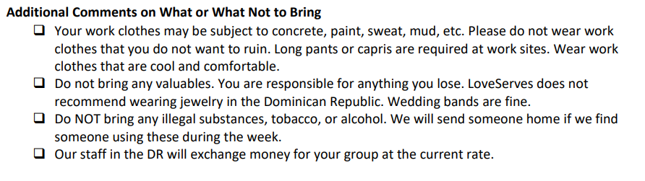
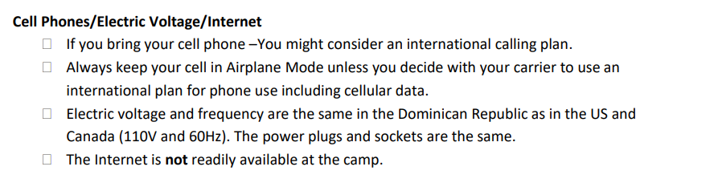

Slide 12
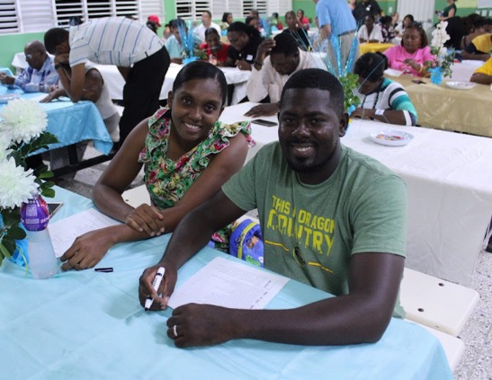
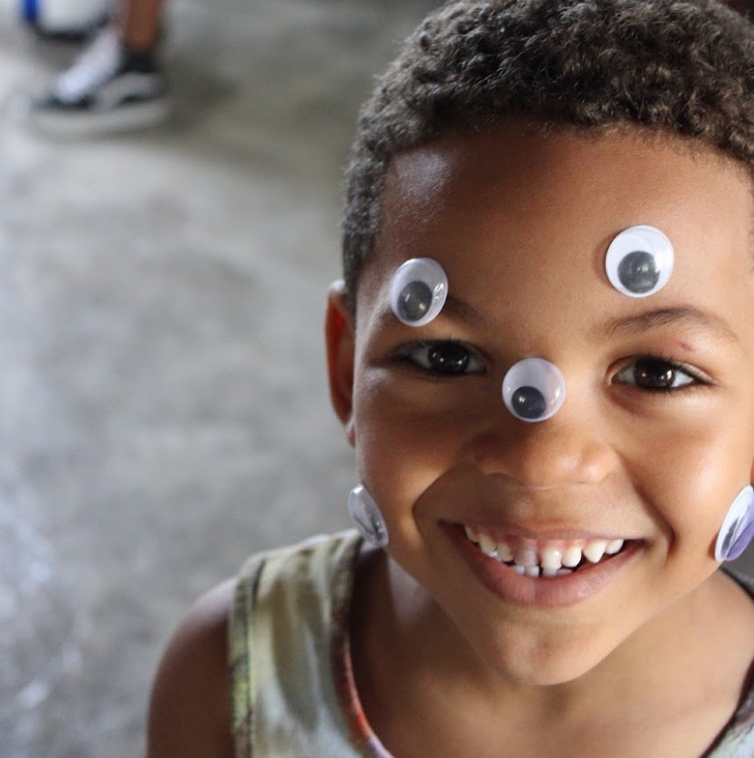
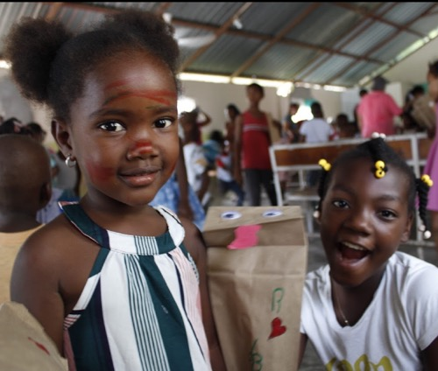
MEETING #1 VIDEO REVIEW
What is poverty?
What impact can we expect from our mission trip?
What can be harmful about a mission trip?
What difference can a mission trip make on YOUR life?
Notes:
Ask: Remember our first video from the last meeting that discussed poverty? Lets review the discussion questions from the last meeting to kick us off on our learning for this meeting.
Facilitator listen for:
What is poverty?
It goes beyond material things – it's how people feel about themselves and their own value. We are all poor. We are all living in broken relationship in 4 fundamental areas: with GOD, with SELF, with OTHERS and with CREATION. We all desperately need to know that we were created for a purpose by a loving, almighty God.
What impact can we expect from our mission trip?
If we go with an attitude of humility, flexibility and an openness to learning, we can be confident that God already has something very personal and very important for each of us to experience on this trip. We can learn a lot from church members and community members – regardless of the circumstances of their material poverty. We can offer fellowship and encouragement to everyone we encounter.
What can be harmful about a mission trip? If we treat the symptoms – misdiagnose the problem by focusing on the lack of “stuff” – we can actually harm the situation further. We need to focus on being Ambassadors of that local church. They are there year-round, intentionally getting to know their community and working on reconciliation of the four key broken relationships. We cannot “fix” the poverty in that community in one week. But if we’re not careful, we can destroy a year worth of trust building work by the local church.
What difference can a mission trip make on YOUR life? The serving trip is a chance to go and LEARN from the local church, SERVE with them and encourage them, and then return and apply the core principles of what we learned, in our own communities. All week long we want to be pointing the people we meet towards Jesus and the local church.
Remember – this trip is one piece of a bigger process. It’s a process of learning. Learning what poverty really is (the root is broken relationships). Learning what helpful poverty alleviation is (our goal is a kingdom focus to be rich in relationship with God). Learning what appropriate roles of outsiders are – we want to HELP without HURTING. We want to learn to engage in poverty alleviation for the long haul.

Slide 14
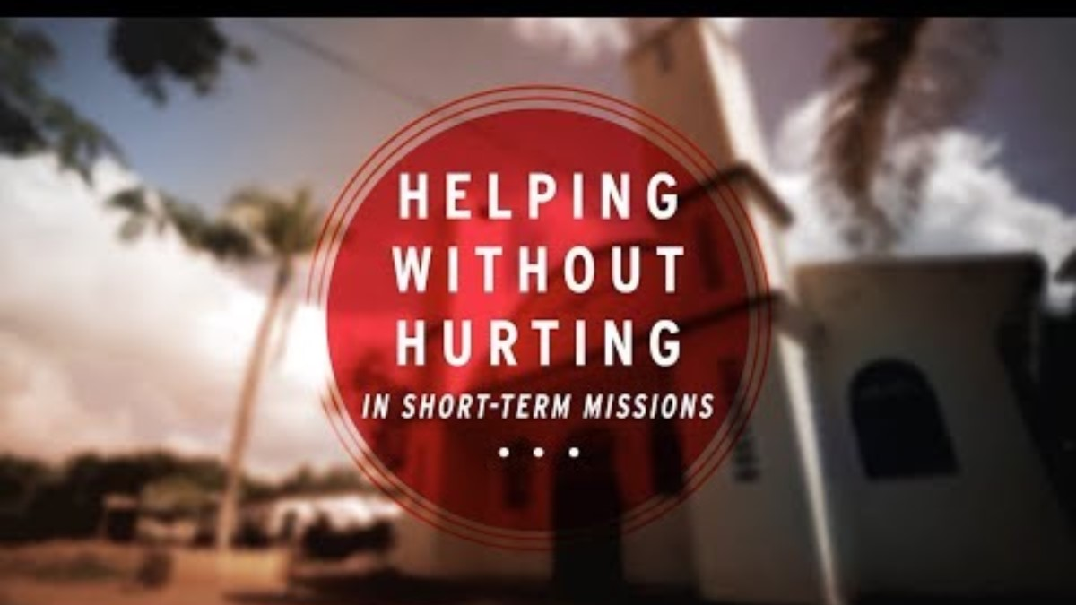
Notes:
Who are the poor

Slide 15
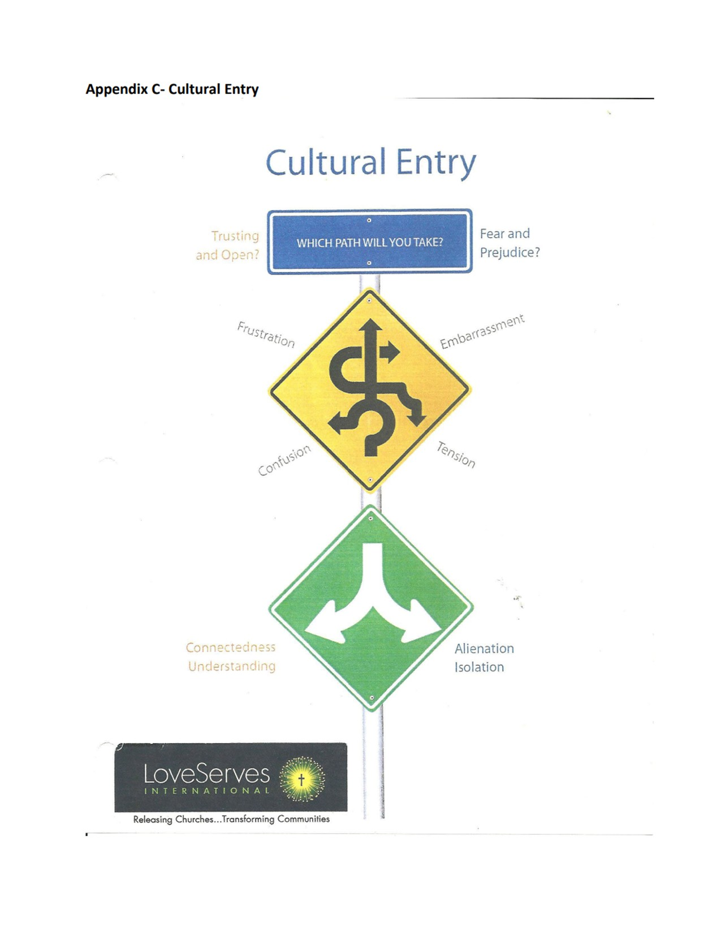
Take some time now to discuss the video with your team, review the handout and answer three questions:
What assumptions were made by the group that came to “help”?
What questions did the group ask while they were “helping”?
What impact will their “help” have on the reputation and community trust of that church?

Slide 16

4 Cultures Activity
4 Cultures
Out Going
Extremely Reserve
Destitute & Angry
Life is Good
Notes:
Four Cultures game. Role playing with different cultures being forced to interact with each other.
Culture 1 - Out-going
You are over the top out-going and a glad hander
You don’t have any personal space and you are too close to the person when talking to them
Everything is happy and exciting. You are the life of the party and you want others to join you.
You want to share your enthusiasm for life with everyone. God is a party.
Culture 2 – Extremely Reserve
You are quiet and very shy. Starting up and carrying on a conversation is painful. You don’t like to talk at all.
You withdraw from people and like to hide in a corner. If someone approaches you it’s awkward. You don’t know if God is real.
You keep things to yourself and you don’t share feelings or anything. You hoard your belongings.
You feel insecure and you want to hold on to materials things. Sharing with others is tough.
Culture 3 – Destitute & Angry
You have absolutely no possessions as you are completely penniless.
Life has thrown you a curveball in every wrong direction. Life and God are not fair.
You are bitter toward the world. Why is everyone else in a better position than you?
You don’t trust anyone and you are on guard all the time. Street smarts are essential.
Culture 4 – Life is Good
You are happy go lucky and carefree. Nothing in the world concerns you.
You are numb to the world events and surroundings as you don’t have any communication to the world around you. You grow and raise all of your food.
Family is important to you. Your entire family lives in your 2-bedroom house including relatives.
You smile a lot and avoid confrontations. You love God.

Slide 17
4 Cultures Activity
Culture 1 - Out-going
You are over the top out-going and a glad hander
You don’t have any personal space, and you are too close to the person when talking to them
Everything is happy and exciting. You are the life of the party, and you want others to join you.
You want to share your enthusiasm for life with everyone. God is a party.
Culture 2 – Extremely Reserve
You are quiet and very shy. Starting up and carrying on a conversation is painful. You don’t like to talk at all.
You withdraw from people and like to hide in a corner. If someone approaches you it’s awkward. You don’t know if God is real.
You keep things to yourself, and you don’t share feelings or anything. You hoard your belongings.
You feel insecure and you want to hold on to materials things. Sharing with others is tough.
Culture 3 – Destitute & Angry
You have absolutely no possessions as you are completely penniless.
Life has thrown you a curveball in every wrong direction. Life and God are not fair.
You are bitter toward the world. Why is everyone else in a better position than you?
You don’t trust anyone, and you are on guard all the time. Street smarts are essential.
Culture 3 – Destitute & Angry
You have absolutely no possessions as you are completely penniless.
Life has thrown you a curveball in every wrong direction. Life and God are not fair.
You are bitter toward the world. Why is everyone else in a better position than you?
You don’t trust anyone, and you are on guard all the time. Street smarts are essential.
Notes:
10 minutes:
Split the group into four teams and give them a culture. There are four different cultures with descriptions of each culture.
Each team then has to understand their own culture and then spend 2-3 minutes with each of the other cultures and let it play out.
Each group needs to be creative with how they interact and they should stay in their own culture thus making it awkward with the interactions.

Slide 18
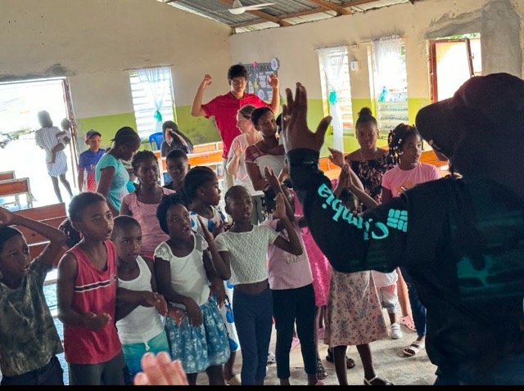
Experimental Learning Cycle
Reflection
Insight
Application
Notes:
Facilitator notes:
Describe what the experimental learning cycle is and why it is important

Slide 19
Experiential Learning Cycle
Reflection
What did you do in this experience?
What happened?
What did you observe?
What feelings did you have participating in this experience?

Slide 20
Experiential Learning Cycle
Insight
What are the implications of what we have just reflected on?
What could be learned from this experience?
Identify some possible learnings.

Slide 21
Experiential Learning Cycle
Application
How might this learning apply to our upcoming mission experience?
Do people’s attitudes affect us? In what ways?
How does my attitude affect other people?
What impact can one person have with a group?

Slide 22
THE FACTS OF LIFE (THE INEVITABLE)
In a cross-cultural setting there will inevitably be frustration, confusion, tension and embarrassment.
These are inescapable experiences of living, working and ministering cross-culturally.
They are part of life. It is simply not true that if you are more spiritual, you will escape these emotions. They are inevitable.

Slide 23
WHAT DO WE DO?
Normally we enter a new or different culture with fear, prejudice, or suspicion. This will happen, and it’s important that we are aware of it.
QUESTION: How are we going to deal with those emotions?
Our choice, however, is to enter with a positive approach of openness, acceptance and trust.
The approach you choose, or the entry posture you choose, can greatly help you cope with cultural differences.

Slide 24
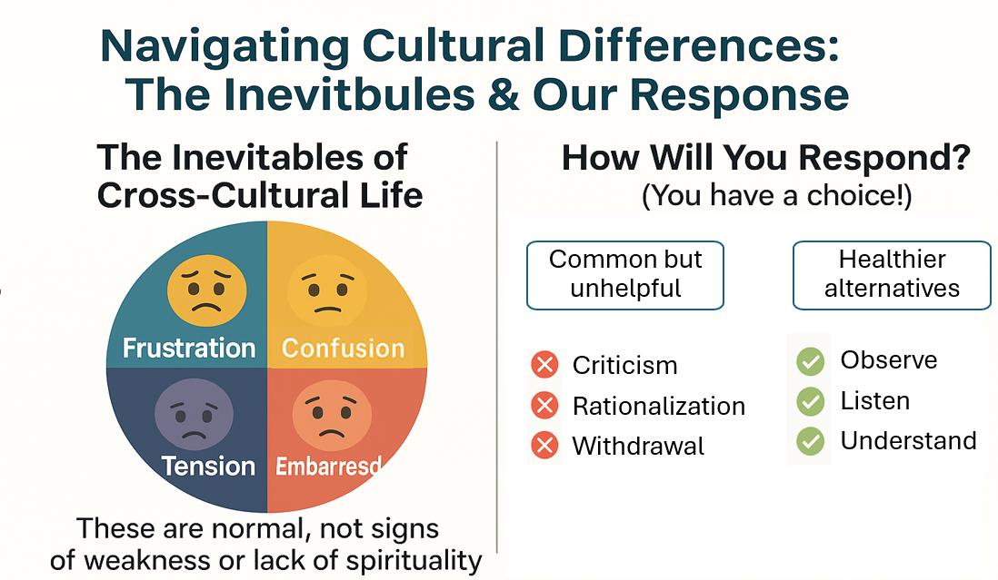
Navigating the Cultural Differences: The Inevitables & Our Responses
Notes:
Coping Strategies (responses) and Results
No matter how you enter the inevitable of a different culture, your response is not inevitable. It’s crucial to realize that you have a choice. You can choose how you’ll react to cultural differences.
Because of the differences from your own culture, the temptation is to react to your frustrations, confusion, embarrassment, or tension with criticism, rationalization, and/or withdrawal.
Results - When you do this, you face the risk of alienation and isolation from the very people you came to get to know and serve (Dominicans) and serve with (team members)
THE BEST CHOICE:
React to your frustrations, confusion, embarrassment, or tension by:
Observing and listening to the new culture
Inquiring about their differences.
For example, when misunderstanding occurs, you need not rationalize your behavior or criticize your host.
You can inquire where the breakdown occurred, where your different backgrounds clashed.
You can learn to observe with more insight, to listen at a deeper level.
This way, you can clarify the issues and apologize for your lack of insight if necessary.
Results - When you do this you greatly enhance the possibility of establishing connection and understanding, which leads to genuine relationship.

Slide 25

Notes:
10 minutes
Homework from meeting 1

Slide 26
TEAM AGENDA AND ROLES: (Team leader fill in based on church needs)
Confirm the planning progress. What are the ideas/plans so far? Share best practices.
  Daily team devotions – need 7 volunteers
  Construction Leader – ____________________
  Home visit Leader – ______________________
  Parenting ministry Leader – _________________
  Youth Work Workshop - ______________________
  Worship Leader – _____________________
  Kids program (approx. _______Kids) – 3 parts: Bible Lesson/songs; Games; Kid Craft
      Leader roles:
      Bible Lessons - ___________________________
      Kid Craft _______________________
      Games - _______________________
REMINDER: Meeting #3 date is:_______________________

